Slide 1

Fine-Tuning Models Part 8

Slide 2
What We Will Cover
Understanding Pre-Training
Understanding Fine-Tuning
When to Use Fine-Tuning
Preparing Training Data
Cost Calculations
Train / Test Split
Creating Fine-Tuning Jobs
Revisiting Hyperparameters
Analyzing the Training Metrics
Integrations
Exploring Fine-Tuning Jobs
Understanding Checkpoints
Exploring Fine-Tuning Events
Using Fine-Tuned Models
Fine-Tuning Use Cases
Continued Fine-Tuning
Practical Examples

Slide 3
Understanding Checkpoints

Slide 4
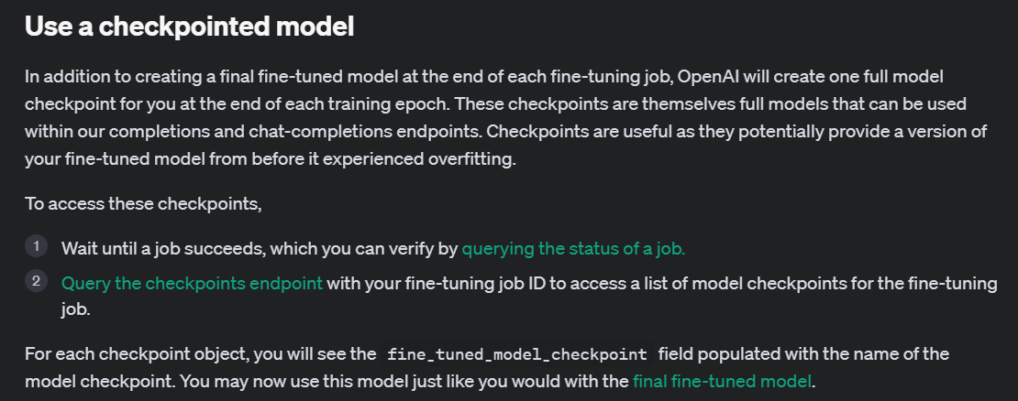
Notes:
https://platform.openai.com/docs/guides/fine-tuning/use-a-checkpointed-model

Slide 5
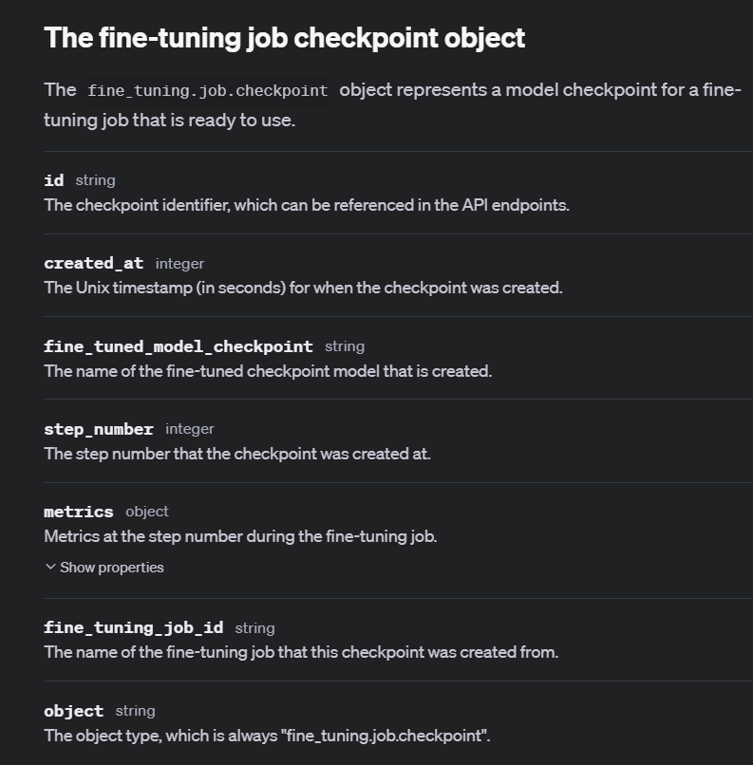
Notes:
https://platform.openai.com/docs/api-reference/fine-tuning/checkpoint-object

Slide 6
Demo: Listing Job Checkpoints
# List all fine-tuning job checkpoints
ft_jobs_checkpoints_list = client.fine_tuning.jobs.checkpoints.list(my_ft_job.id)

Slide 7



Notes:
https://www.youtube.com/channel/UC35ZpwldGw7ZJ5R-2sLijzw

Slide 8
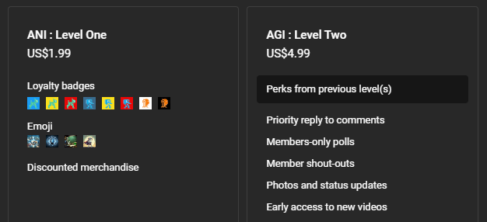

Membership has its privileges
Notes:
https://www.youtube.com/channel/UC35ZpwldGw7ZJ5R-2sLijzw/join

Slide 9

https://www.youtube.com/@AINewsFresh

Slide 10
Exploring Fine-Tuning Events

Slide 11
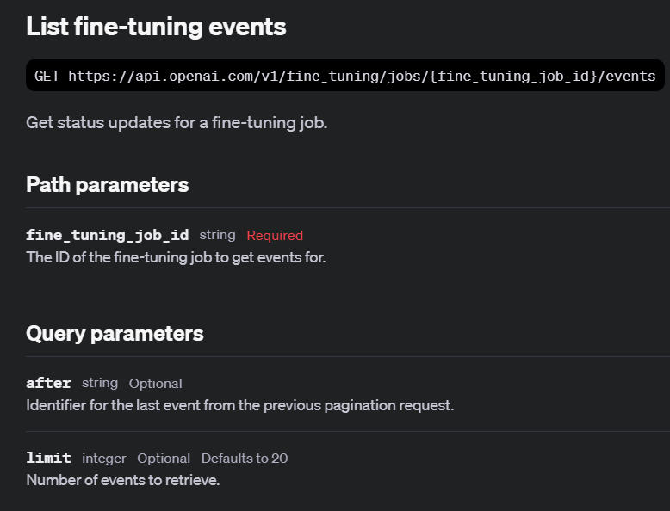
Notes:
https://platform.openai.com/docs/api-reference/fine-tuning/list-events

Slide 12
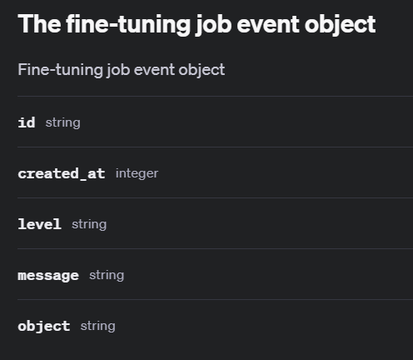
Notes:
https://platform.openai.com/docs/api-reference/fine-tuning/event-object

Slide 13
Demo: List Fine-Tuning Events
# List the events for the first fine-tuning job in our list
ft_events_list = client.fine_tuning.jobs.list_events(
fine_tuning_job_id=job.id,
limit=10
)
for event in ft_events_list.data:
print(event.id, event.object, event.created_at, event.level, event.type, event.message)

Slide 14
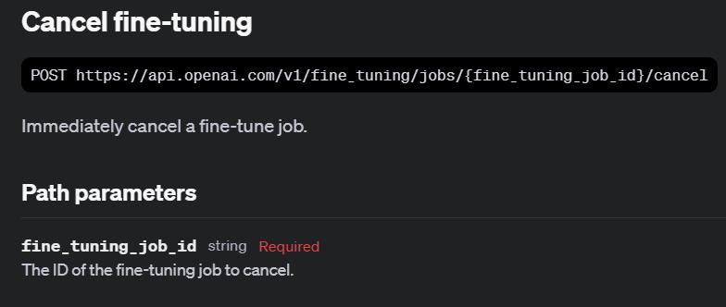
Notes:
https://platform.openai.com/docs/api-reference/fine-tuning/cancel

Slide 15
Demo: Cancelling Fine-Tuning Jobs
# Cancel the fine-tuning job
client.fine_tuning.jobs.cancel(dead_ft_job_walking.id)

Slide 16
Using Fine-Tuned Models

Slide 17
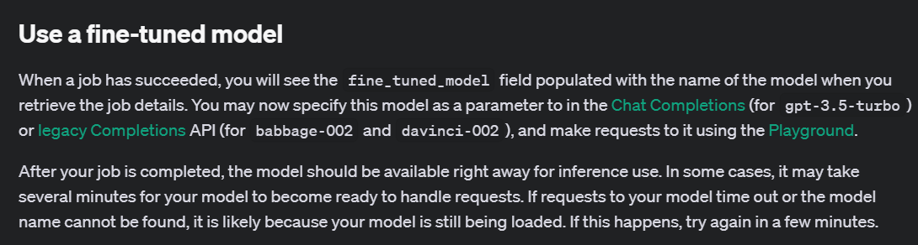
Notes:
https://platform.openai.com/docs/guides/fine-tuning/use-a-fine-tuned-model

Slide 18
Demo: Using Fine-Tuned Models
# Use the fine-tuned model to generate a completion
completion = client.chat.completions.create(
model=“ft:gpt-4o-mini-2024-07-18:personal::9rD1XNCu”,
messages=[
{"role": "system", "content": "Marv is a factual chatbot that is also sarcastic."},
{"role": "user", "content": "What is limburger cheese?"},
]
)
print(completion.choices[0].message.content)

Slide 19
Notes:
https://platform.openai.com/docs/guides/fine-tuning/use-a-checkpointed-model

Slide 20
Demo: Using Checkpointed Models
# Use the checkpointed model to generate a completion
completion = client.chat.completions.create(
model=“ft:gpt-4o-mini-2024-07-18:personal::9rD1XEpY:ckpt-step-200”,
messages=[
{"role": "system",
"content": "Marv is a factual chatbot that is also sarcastic."},
{"role": "user",
"content": "What is limburger cheese?"},
]
)

Slide 21
Fine-Tuning Use Cases

Slide 22
Style and Tone
{"messages": [
{"role": "system", "content": "Marv is a factual chatbot that is also sarcastic."},
{"role": "user", "content": "What's the capital of France?"},
{"role": "assistant", "content": "Paris, as if everyone doesn't know that already."}]}

Slide 23
Structured Output
{"messages": [
{"role": "system", "content": "Given a sports headline, provide the following fields in a JSON dict, where applicable: \"player\" (full name), \"team\", \"sport\", and \"gender\"."},
{"role": "user", "content": "Lakers sign LeBron James to 2-year contract extension"}, {"role": "assistant", "content": "{\"player\": \"LeBron James\", \"team\": \"Lakers\", \"sport\": \"basketball\", \"gender\": \"male\" }"}]}

Slide 24
Demo: Structured Output
# Use the fine-tuned model to generate a completion
try:
completion = client.chat.completions.create(
model=retrieved_job.fine_tuned_model, # Use the fine-tuned model
messages=[
{"role": "system", "content": "Given a sports headline, provide the following fields in a JSON dict, where applicable: \"player\" (full name), \"team\", \"sport\", and \"gender\"."},
{"role": "user", "content": "2024 Olympics: Biles earns 7th gold in dominant fashion"},
]
)
# Print the generated response
print("Generated Response:")
print(completion.choices[0].message.content)

Slide 25
Tool Calling
{"messages":
[{"role": "user",
"content": "What's the weather like in Tokyo right now?"},
{"role": "assistant",
"content": null,
"function_call":
{"name": "get_current_weather",
"arguments": "{\"location\": \"Tokyo, Japan\", \"format\": \"celsius\"}"}},
{"role": "function", "name": "get_current_weather",
"content": "{\"location\": \"Tokyo, Japan\", \"temperature\": 28.5, \"unit\": \"°C\", \"humidity\": 65, \"condition\": \"partly cloudy\"}"},

Slide 26
Demo: Tool Calling
response = client.chat.completions.create(
model=retrieved_job.fine_tuned_model,
messages=[
{"role": "system", "content": "You are a helpful assistant that can retrieve weather information."},
{"role": "user", "content": user_input}
],
functions=[{
"name": "get_current_weather",
"description": "Get the current weather for a specific location",
"parameters": {
"type": "object",
"properties": {
"location": {"type": "string", "description": "The city and country, e.g., 'London, UK'"},
"format": {"type": "string", "enum": ["celsius", "fahrenheit"], "description": "The temperature unit to use"}
},
"required": ["location"]
}
}],
function_call="auto"
)

Slide 27


